Slide 1
Master thesis
Dynamic positioning, system identification and control of marine vessels - based on a vessel model

Slide 2
Presentation
Thesis: Dynamic positioning, system identification and control of marine vessels - based on a vessel model
Candidate: Tommy Sneltvedt
Supervisor: Associate Professor Dr. David Luigi Di Ruscio
Date: 17.11.2025
Time: 09:00-11:00

Slide 3
Agenda
Brief introduction to DP
Controller algorithms
System identification
Path following and trajectory tracking
Environmentally friendly DP mode
Thruster allocation

Slide 4
Brief introduction to dynamic positioning
Highlight some key concepts associated with DP

Slide 5
Dynamic positioning
Dynamic positioning is the art of position keeping.
It is responsible for controlling the thruster inputs to maintain position and attitude in the presence of environmental disturbances.
This is one of the key technologies that makes the modern offshore industry possible.

Slide 6
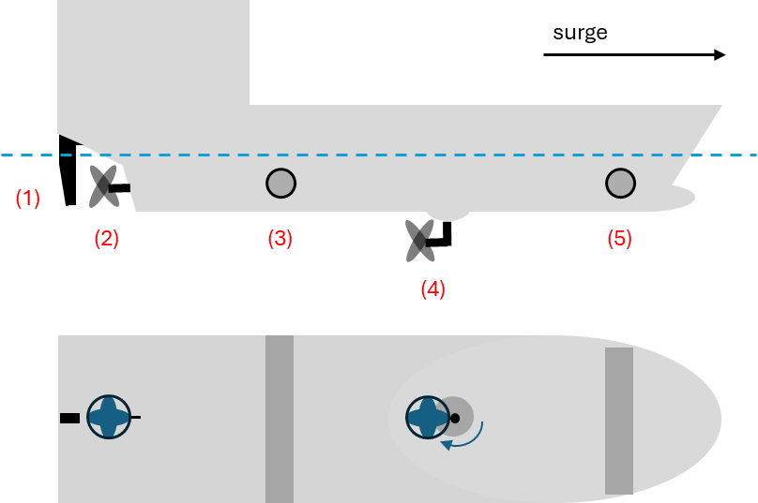
Thrusters
Type of thrusters:
Main propellers
Tunnel thrusters
Azimuth thrusters
These thruster can be subdivided into:
Fixed pitch thrusters
Controllable pitch thrusters

Slide 7
Environmental disturbances
Environmental disturbances:
Wind – Use wind model suggested by Fossen¹
Waves – Use random walk model
Current – Use random walk model
1: From the book: “Marine Craft Hydrodynamics and Motion Control”

Slide 8
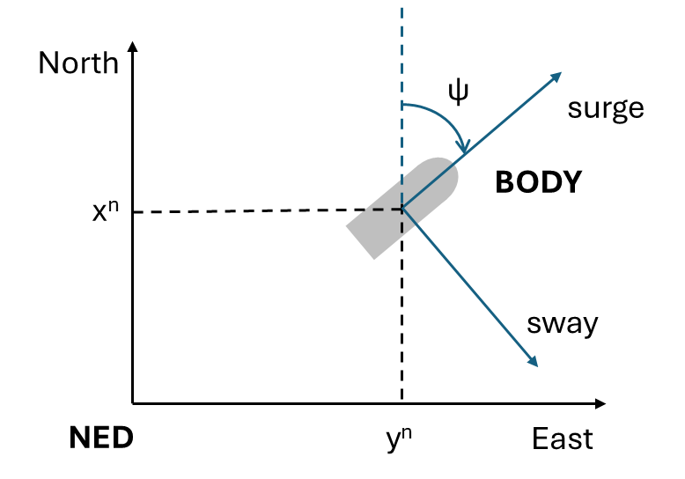
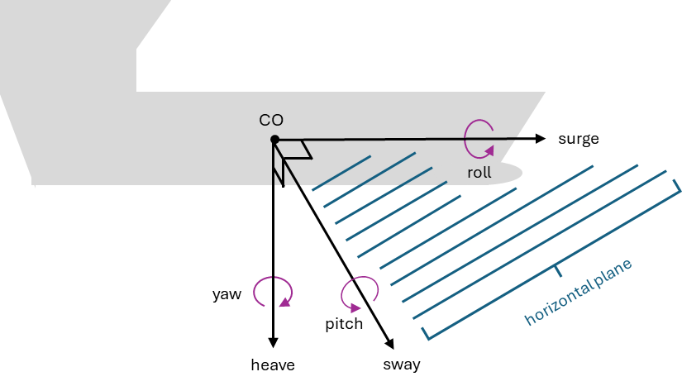
Coordinate systems
We consider vessels with three degrees of freedom: surge, sway and yaw.

Slide 9
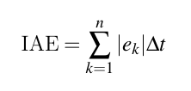
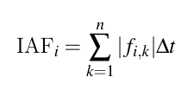
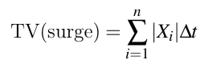
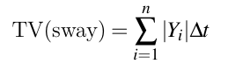
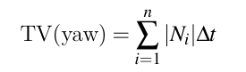
Metrics
Integrated Absolute Error (IAE):
Integrated Absolute thruster Force (IAF):
Total Value (TV):
Here X, Y and N refers to net force in surge direction, sway direction and moment in yaw.

Slide 10
Controller algorithms
Controller algorithms for dynamic positioning

Slide 11
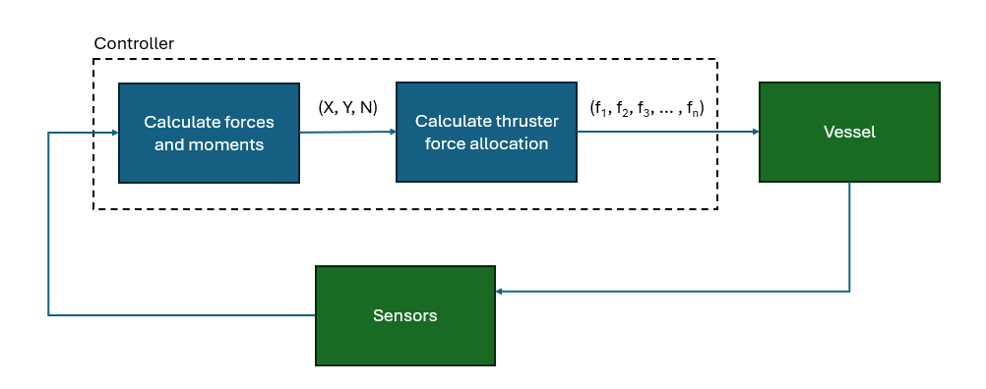
Twofold control process
Step 1: Calculate the net force in surge and sway, together with the corresponding yaw moment needed for position-keeping.
Step 2: Realize these forces by distributing forces to individual thrusters (thruster allocation).

Slide 12
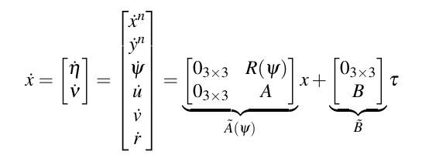
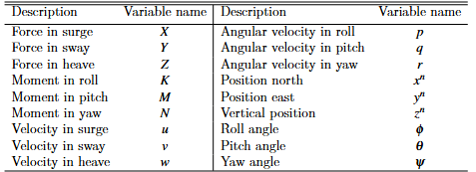
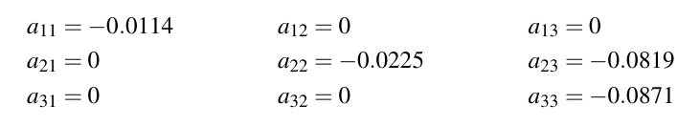
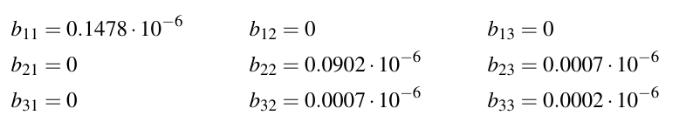
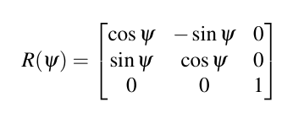
Supply model
Supply model
Miscellaneous
SNAME naming convention:
Rotation matrix
This vessel model is related to hydrodynamic added mass (M) and damping (D) as follows:

Slide 13
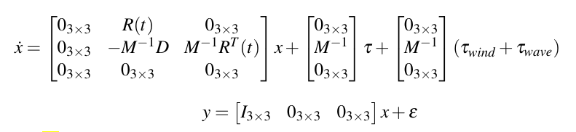
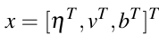
DP model (used in Kalman filter)
Same model structure as supply model. The extra row contains the DP current, representing integral action. This is estimated by the Kalman filter. This is an extension of the supply model that includes DP current.
Here, b represent DP current.
Estimated by Kalman filter.

Slide 14
Control algorithms
LQ optimal control on deviation form.
MPC – Three formulation for estimating the prediction horizon:
Constant heading for the entire horizon.
Constant heading rate for the entire horizon.
Estimate future horizon by calculating future values states previous optimal input u*(t_{k-1}).
These formulations all use the estimated DP current together with sensor inputs on waves and wind.
NMPC. This method uses the DP current together with sensor inputs on waves and wind.

Slide 15
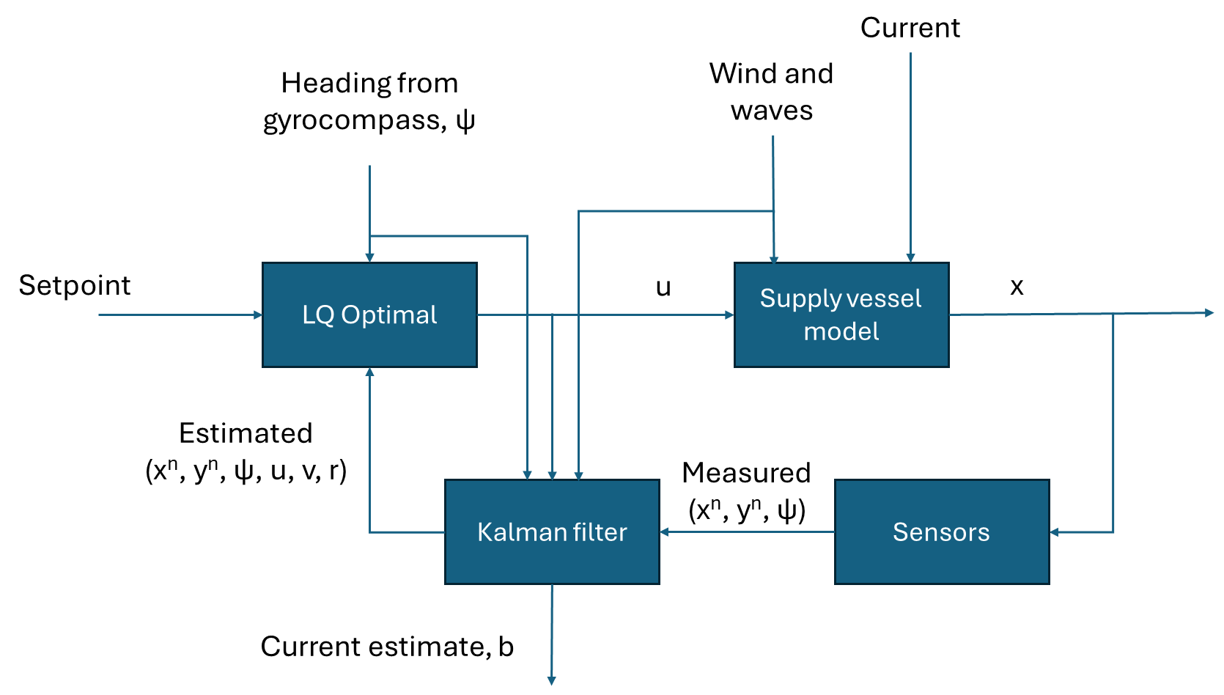
LQ optimal control structure

Slide 16
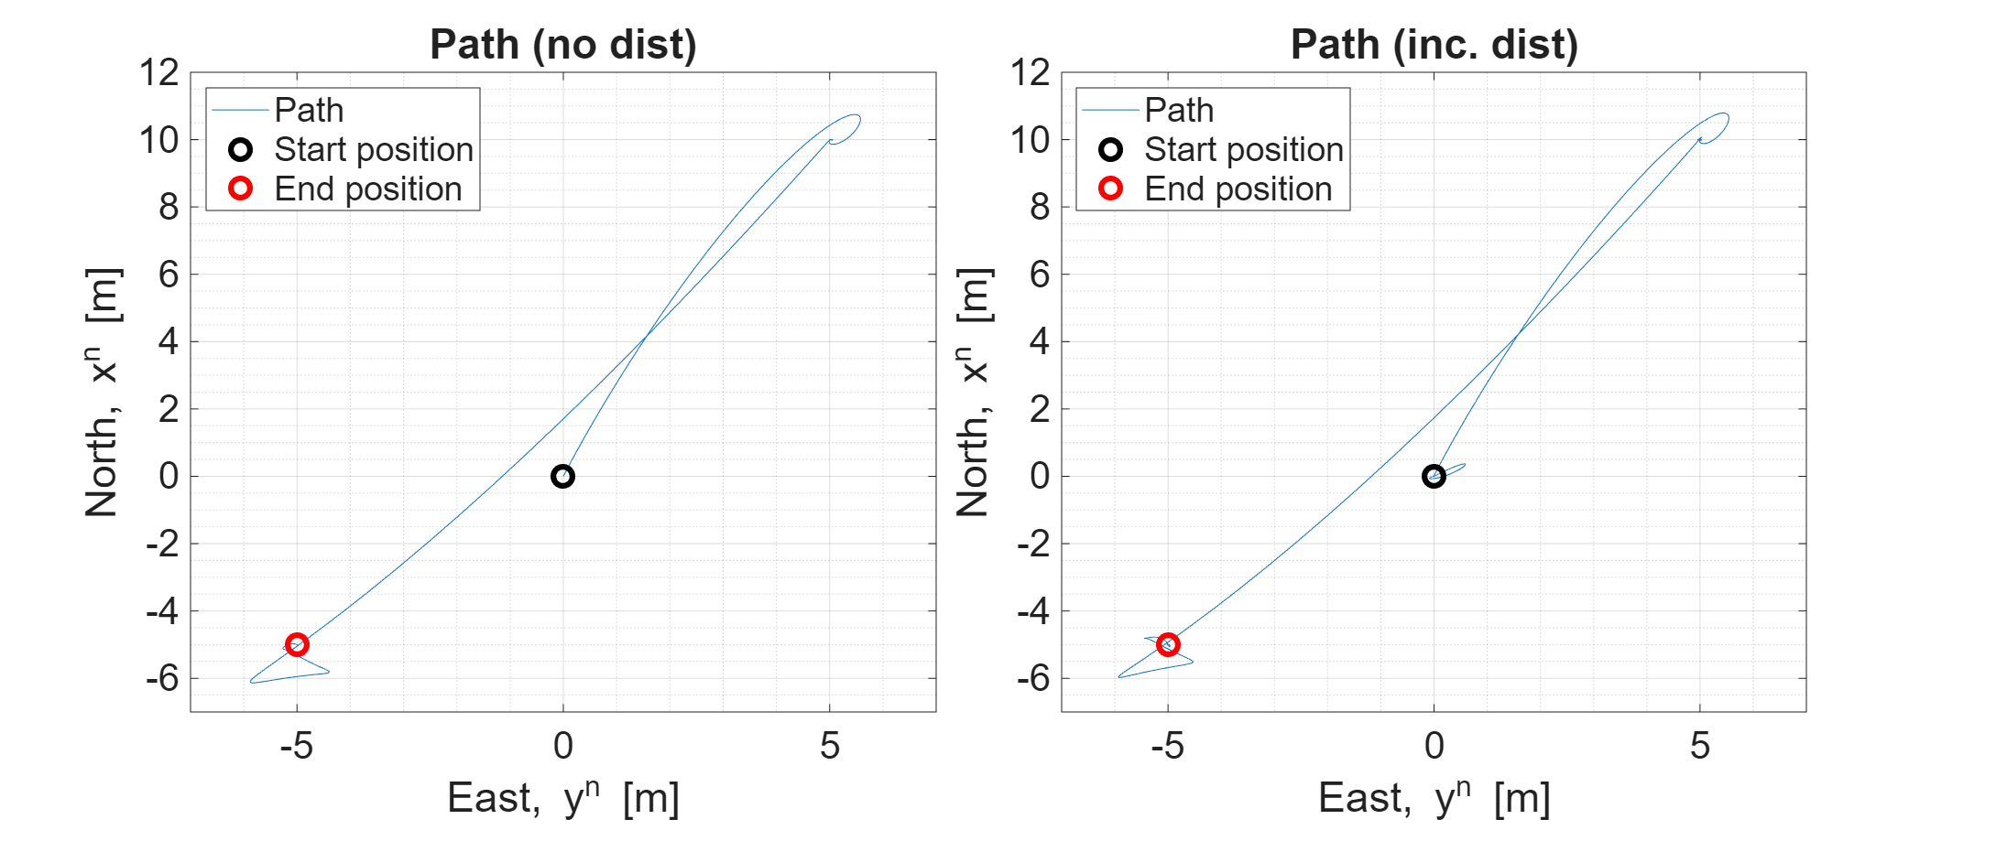
Control of supply vessel using LQ optimal control (1)
[0, 0, 0°]
[10, 5, 26°]
[-5, -5, 225°]
t = 100
t =600

Slide 17
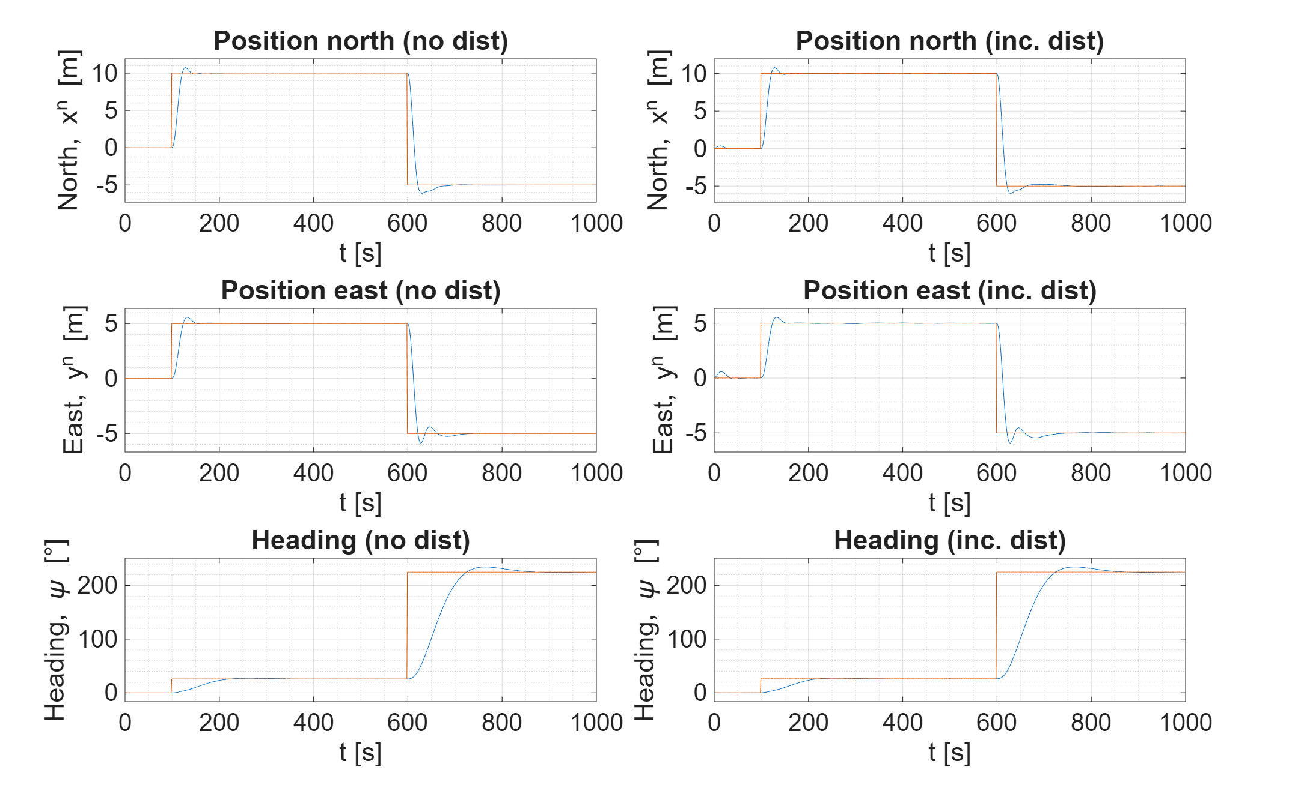
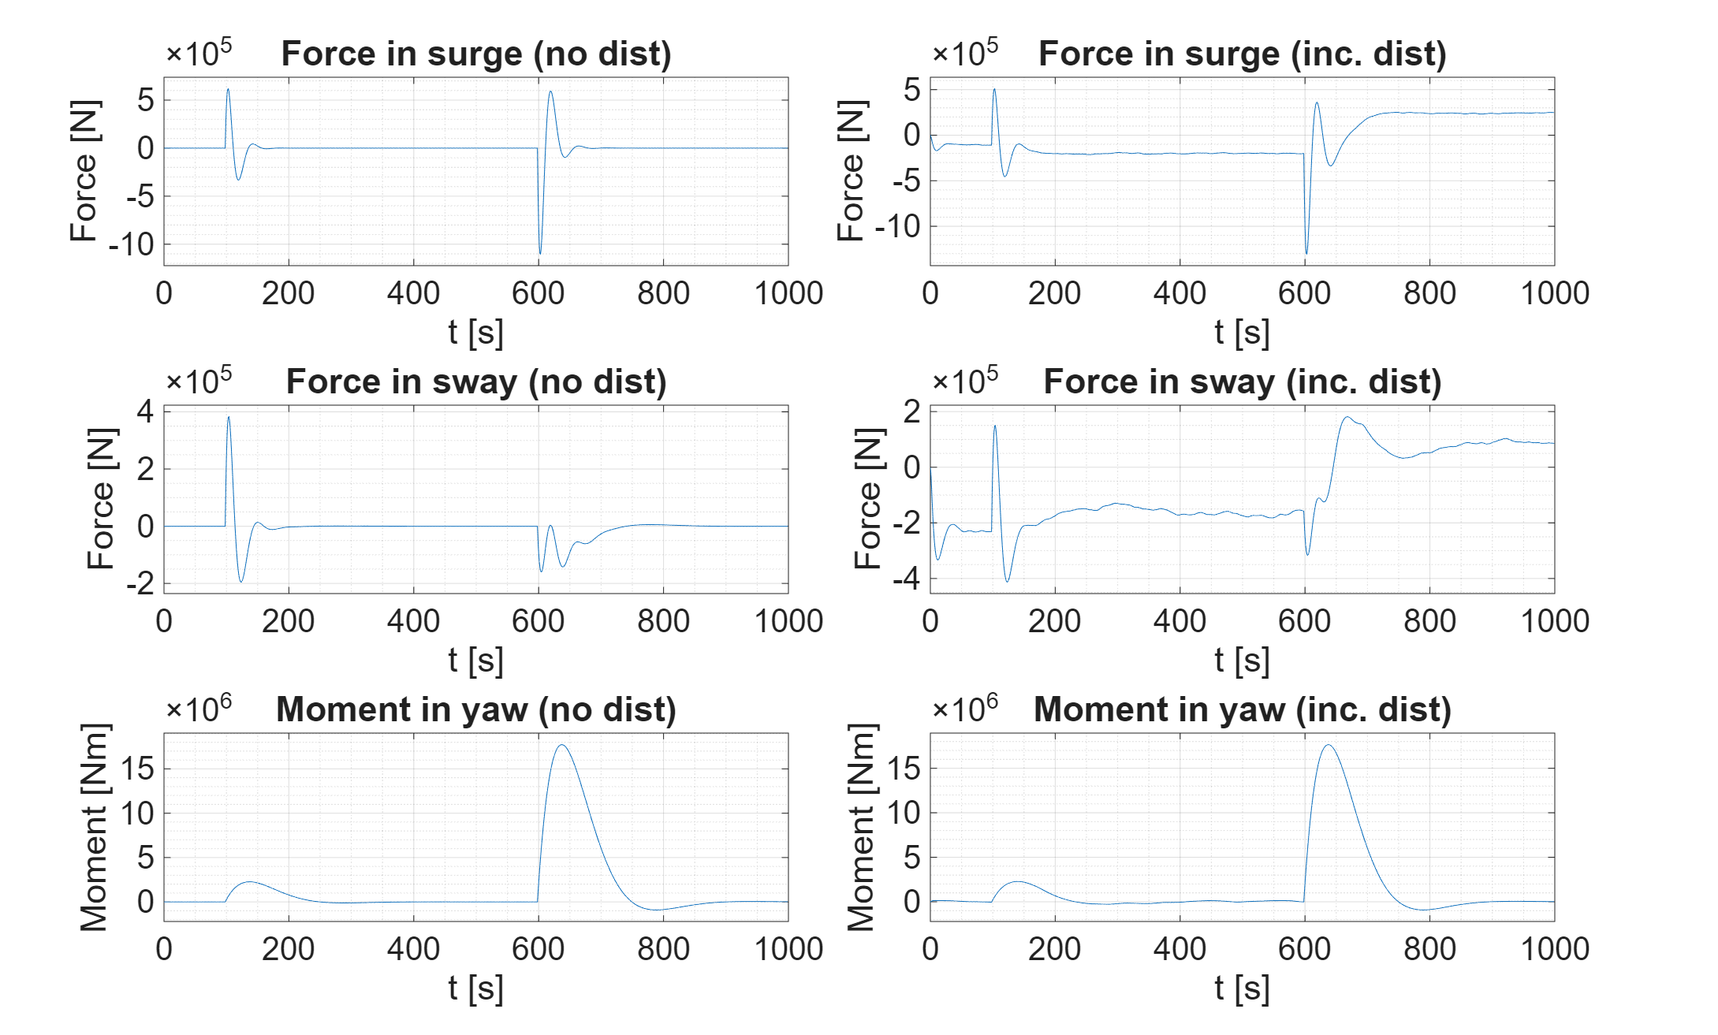
Control of supply vessel using LQ optimal control (2)
Setpoint tracking – Shows the north and east position together with the yaw angle
Inputs – Shows input values from controller: force in surge, force in sway, and momentum in yaw.

Slide 18
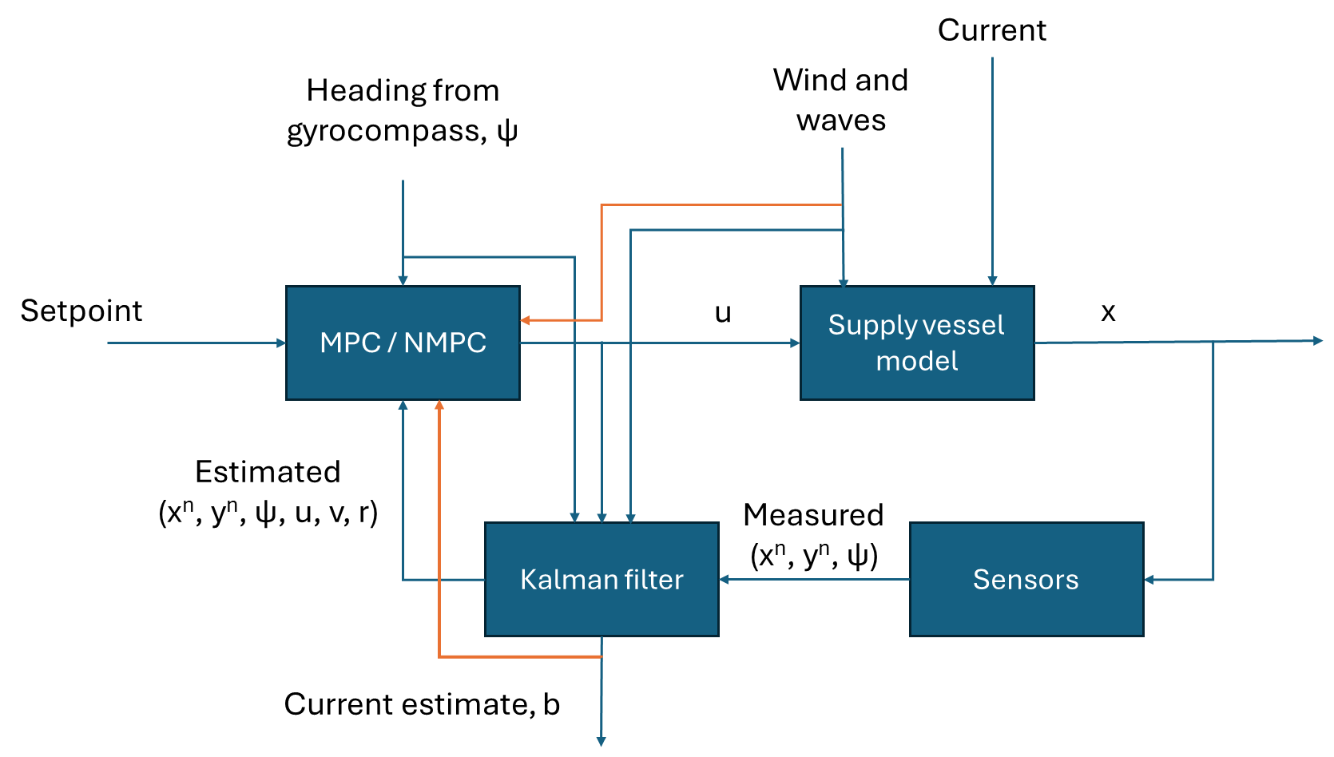
MPC/NMPC control structure

Slide 19
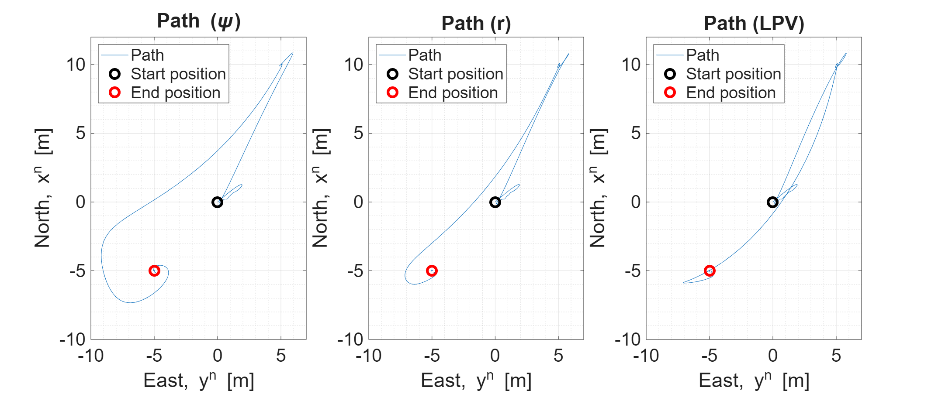
Control of supply vessel using different MPC formulations (1)
[0, 0, 0°]
[10, 5, 26°]
[-5, -5, 225°]
t = 100
t =600

Slide 20
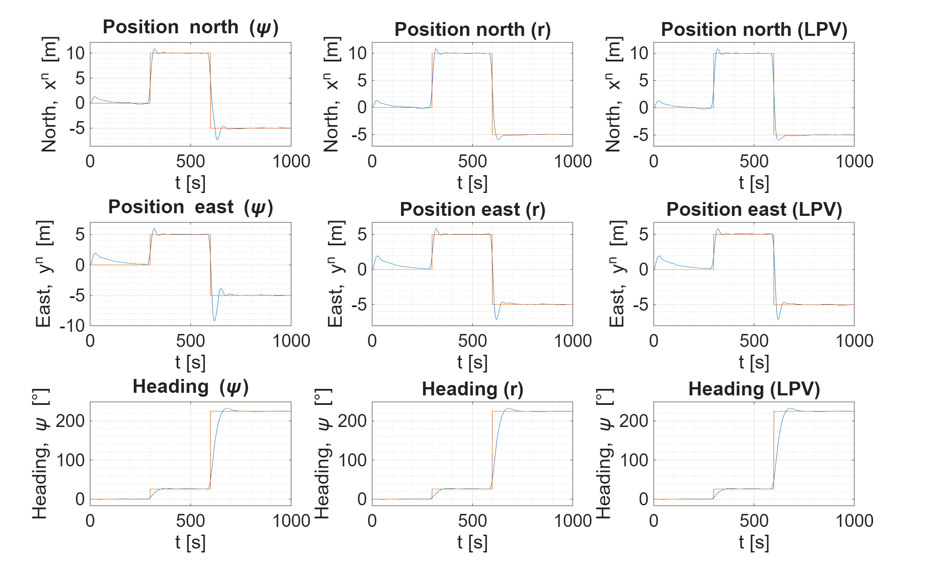
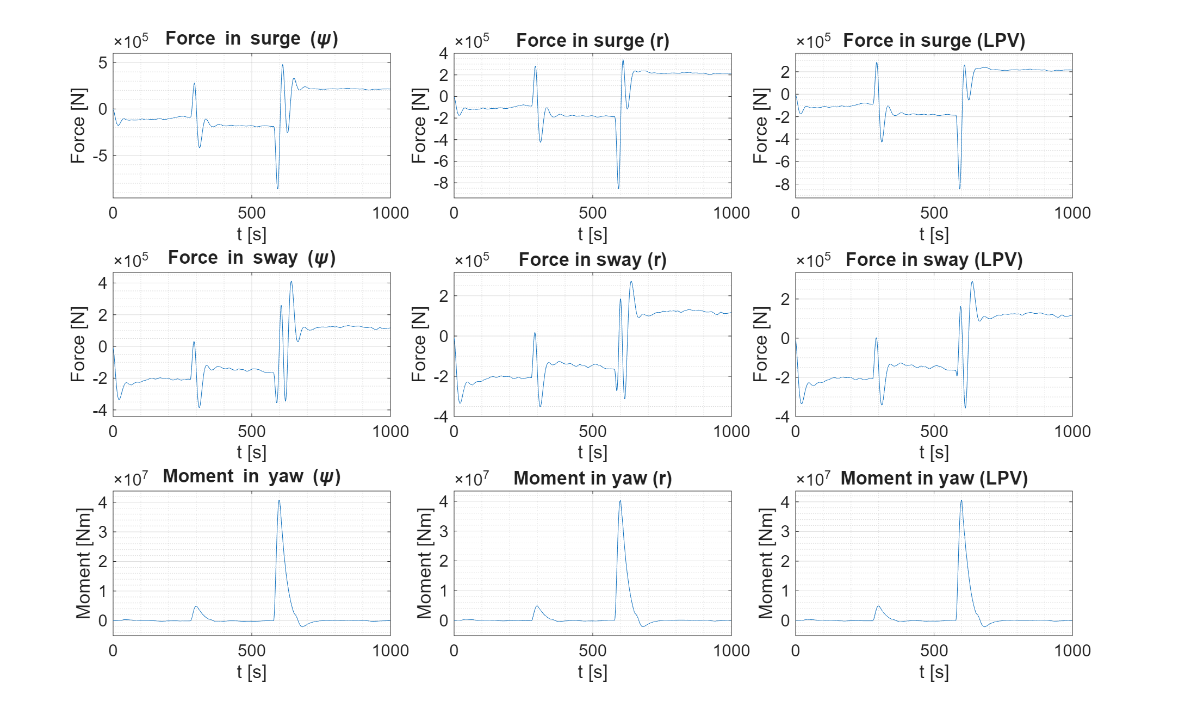
Control of supply vessel using different MPC formulations (2)
Setpoint tracking – Shows the north and east position together with the yaw angle
Inputs – Shows input values from controller: force in surge, force in sway, and momentum in yaw.

Slide 21
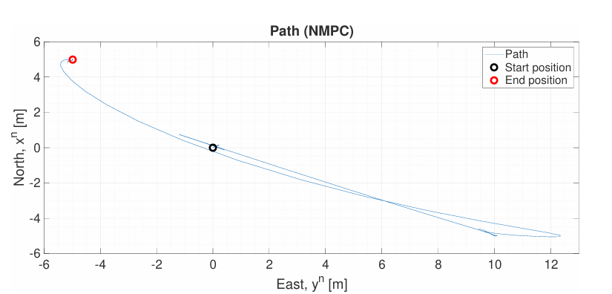
Control of supply vessel using different NMPC formulations (1)
[0, 0, 0°]
[-5, 10, -26°]
[5, -5, 135°]
t = 100
t =600

Slide 22
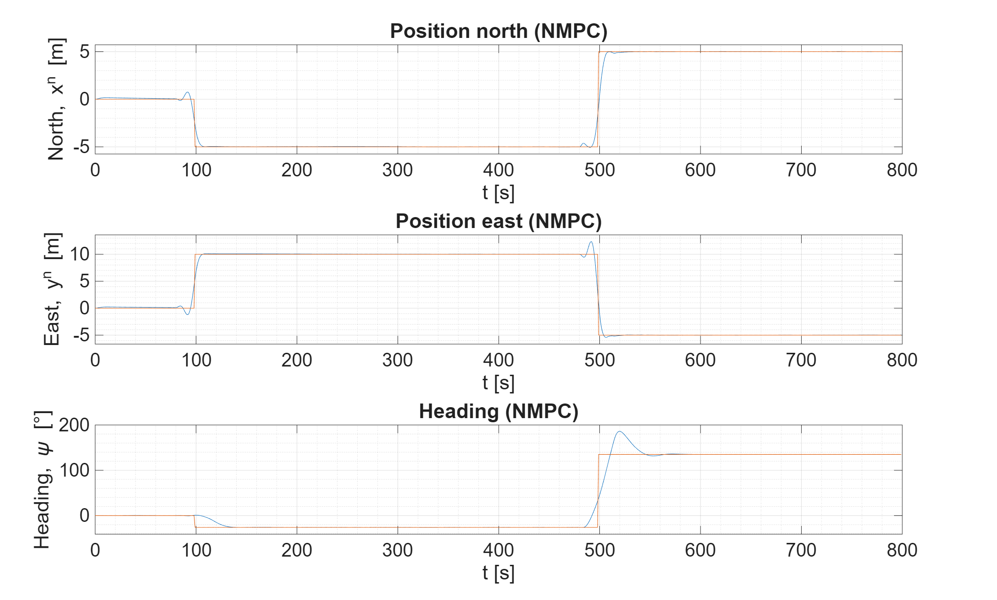
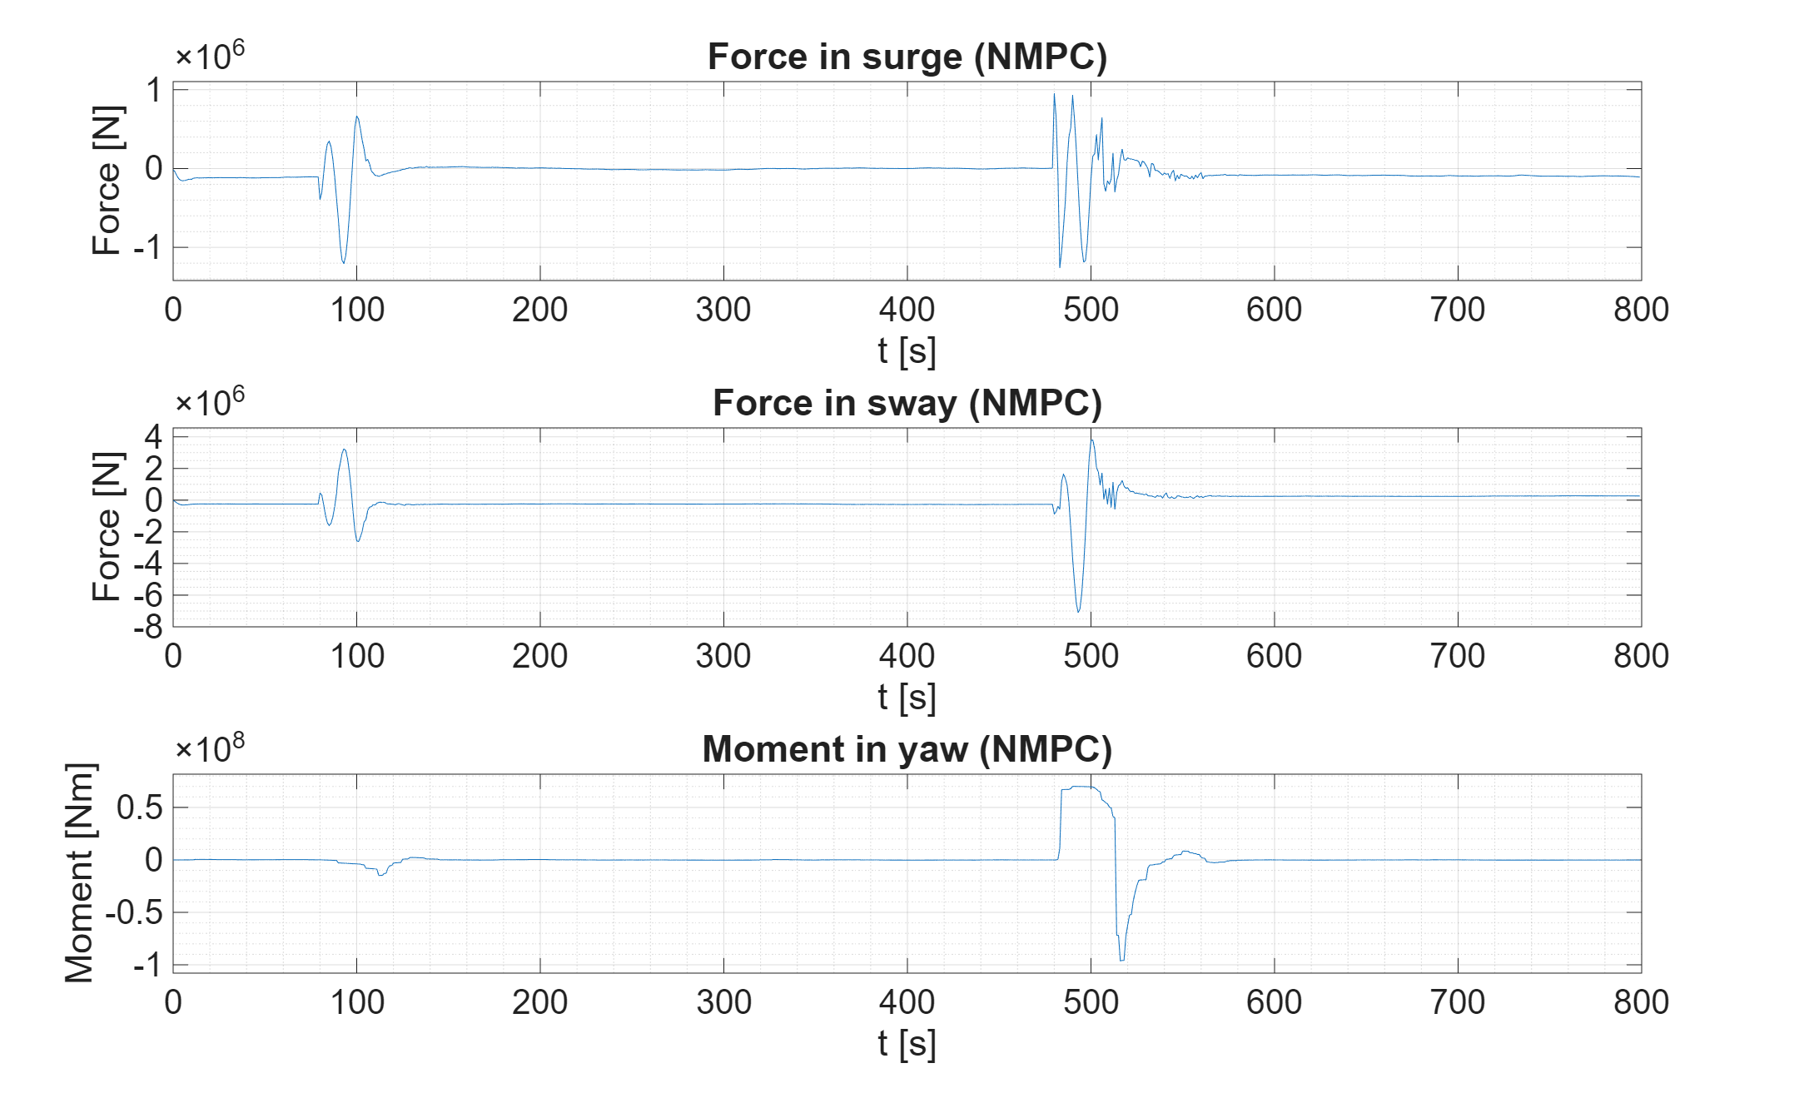
Control of supply vessel using different NPC formulations (2)
Setpoint tracking – Shows the north and east position together with the yaw angle
Inputs – Shows input values from controller: force in surge, force in sway, and momentum in yaw.

Slide 23
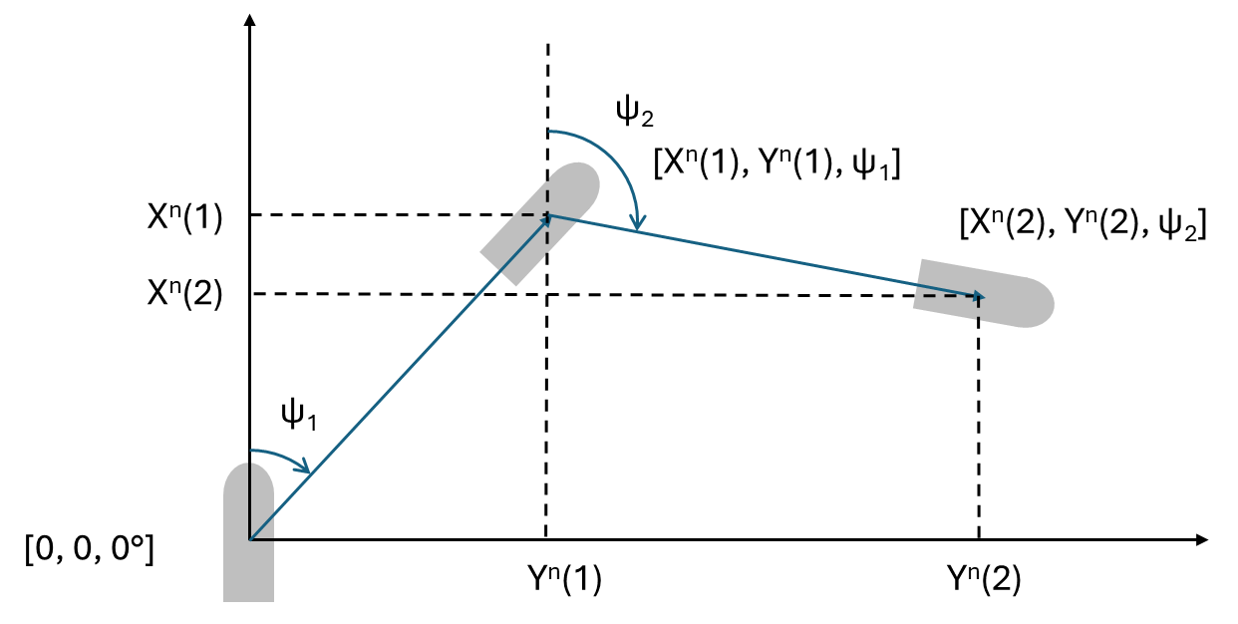
Monte Carlo simulations
To verify that the controller algorithms can handle varying weather conditions and operational demands, Monte Carlo simulations are run a 100 times for each controller.
The setpoint is changes at to time instances t = 100 and t = 600. All these simulations lasts for a 1000 seconds.
The setpoint is moved in some random direction for ten meters both times. The heading setpoint is set equal to this new direction.
Environmental conditions are varied each time since they depend on different seeds for every simulation.

Slide 24
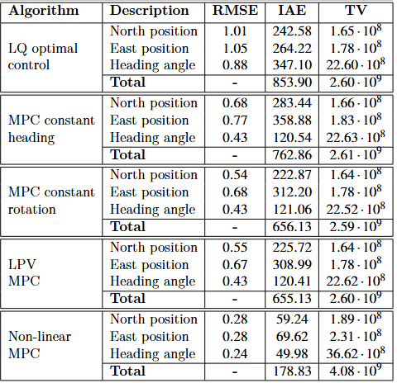
Summary
Monte Carlo simulation results depicted on the right. LPV and constant rotation formulation are the preferred MPC methods.
NMPC is the most aggressive method here. It shows that there is a tradeoff between lowering setpoint error and total value. This is true for all the algorithms if retuned.

Slide 25
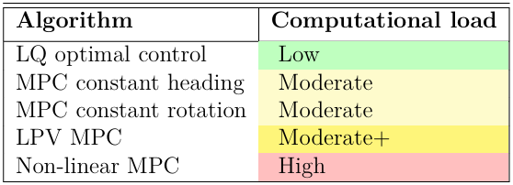
Summary (2)
It is the author’s experience that the LQ optimal control was the easiest to tune.
It is also the fastest algorithm to run.
Non-linear MPC is both computationally heavy and not trivial to tune. It is the authors opinion the worst solution here. Should only be used for specialized operations like Green DP.

Slide 26
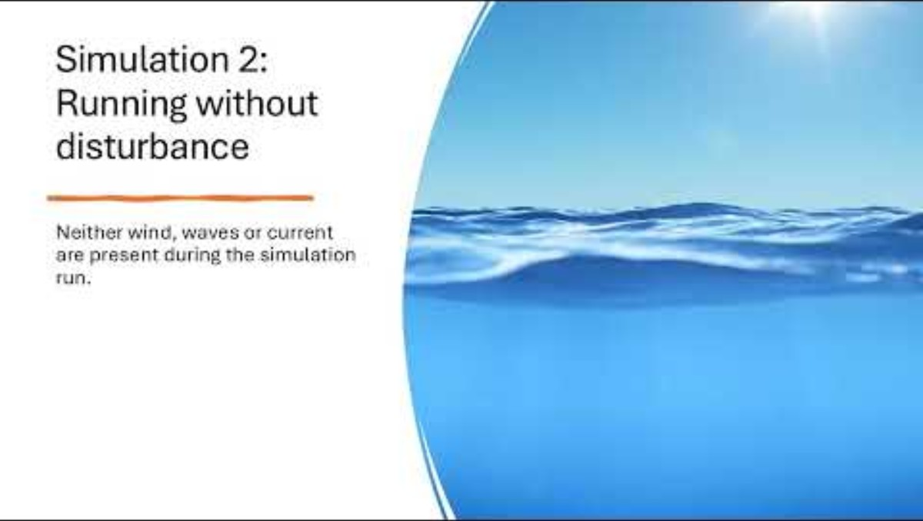
Demonstration – LQ optimal control

Slide 27
System identification
Model identification and control based on data collection

Slide 28
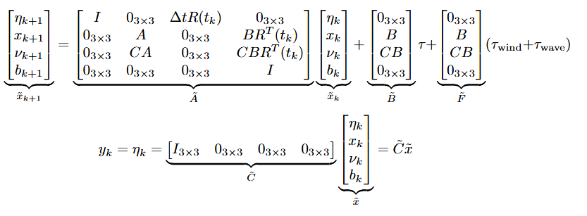
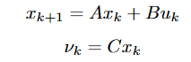
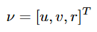
System identification
Step 1: Identify body dynamics
Step 2: Make new identified vessel model by inserting the identified matrices into the following structure
Run open loop simulation with input generated from PRBS¹. Identify the relation between the linear and angular velocities:
where,
This can be used in the Kalman filter and model-based controllers (without b term in the LQ optimal controller) to control the original vessel identified.
1: Pseudo Random Binary Signal

Slide 29
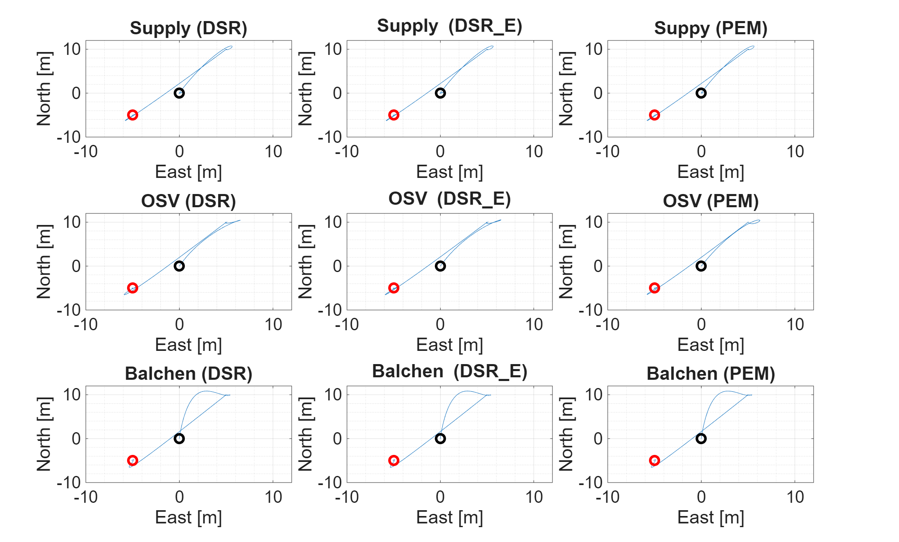
Path plot when identifying model with different identification methods
Three different models identified:
Supply
Balchen (nonlinear)
OSV (nonlinear)
Three different identification methods:
DSR
DSR_e
PEM

Slide 30
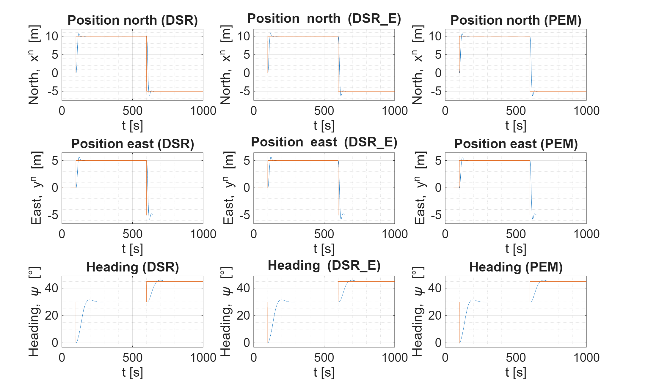
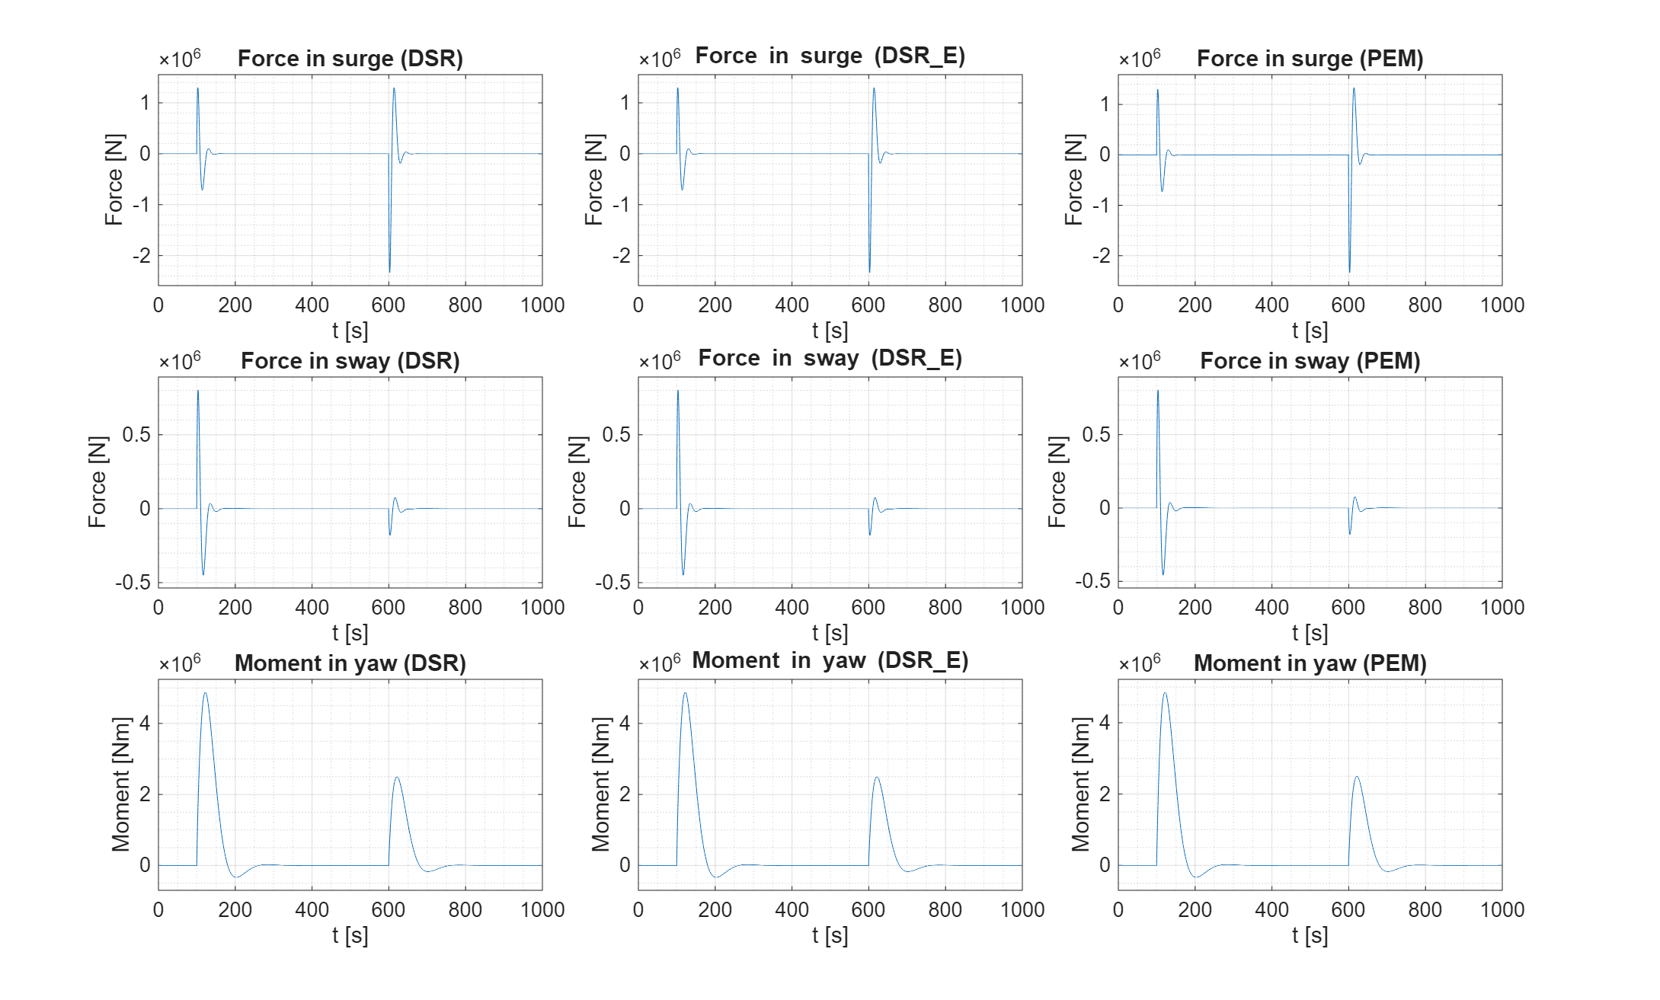
Control of SI identified vessel (supply) using LQ optimal control
Setpoint tracking – Shows the north and east position together with the yaw angle
Inputs – Shows input values from controller: force in surge, force in sway, and momentum in yaw.

Slide 31
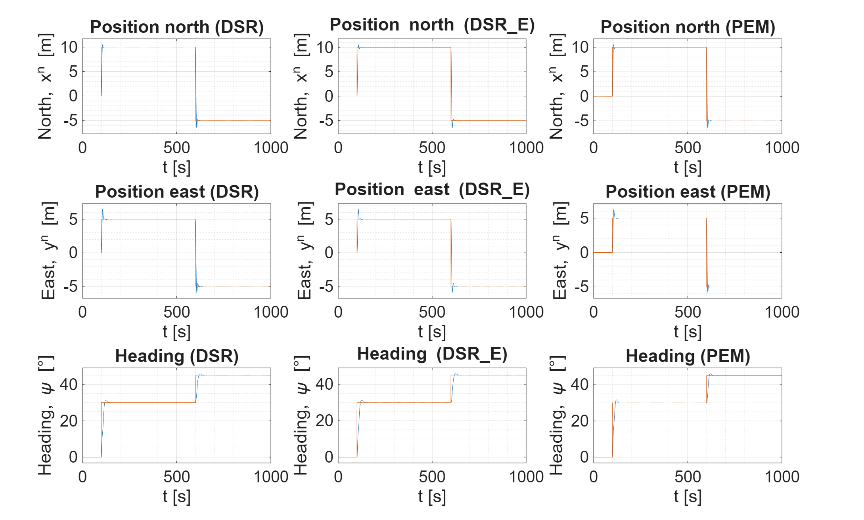
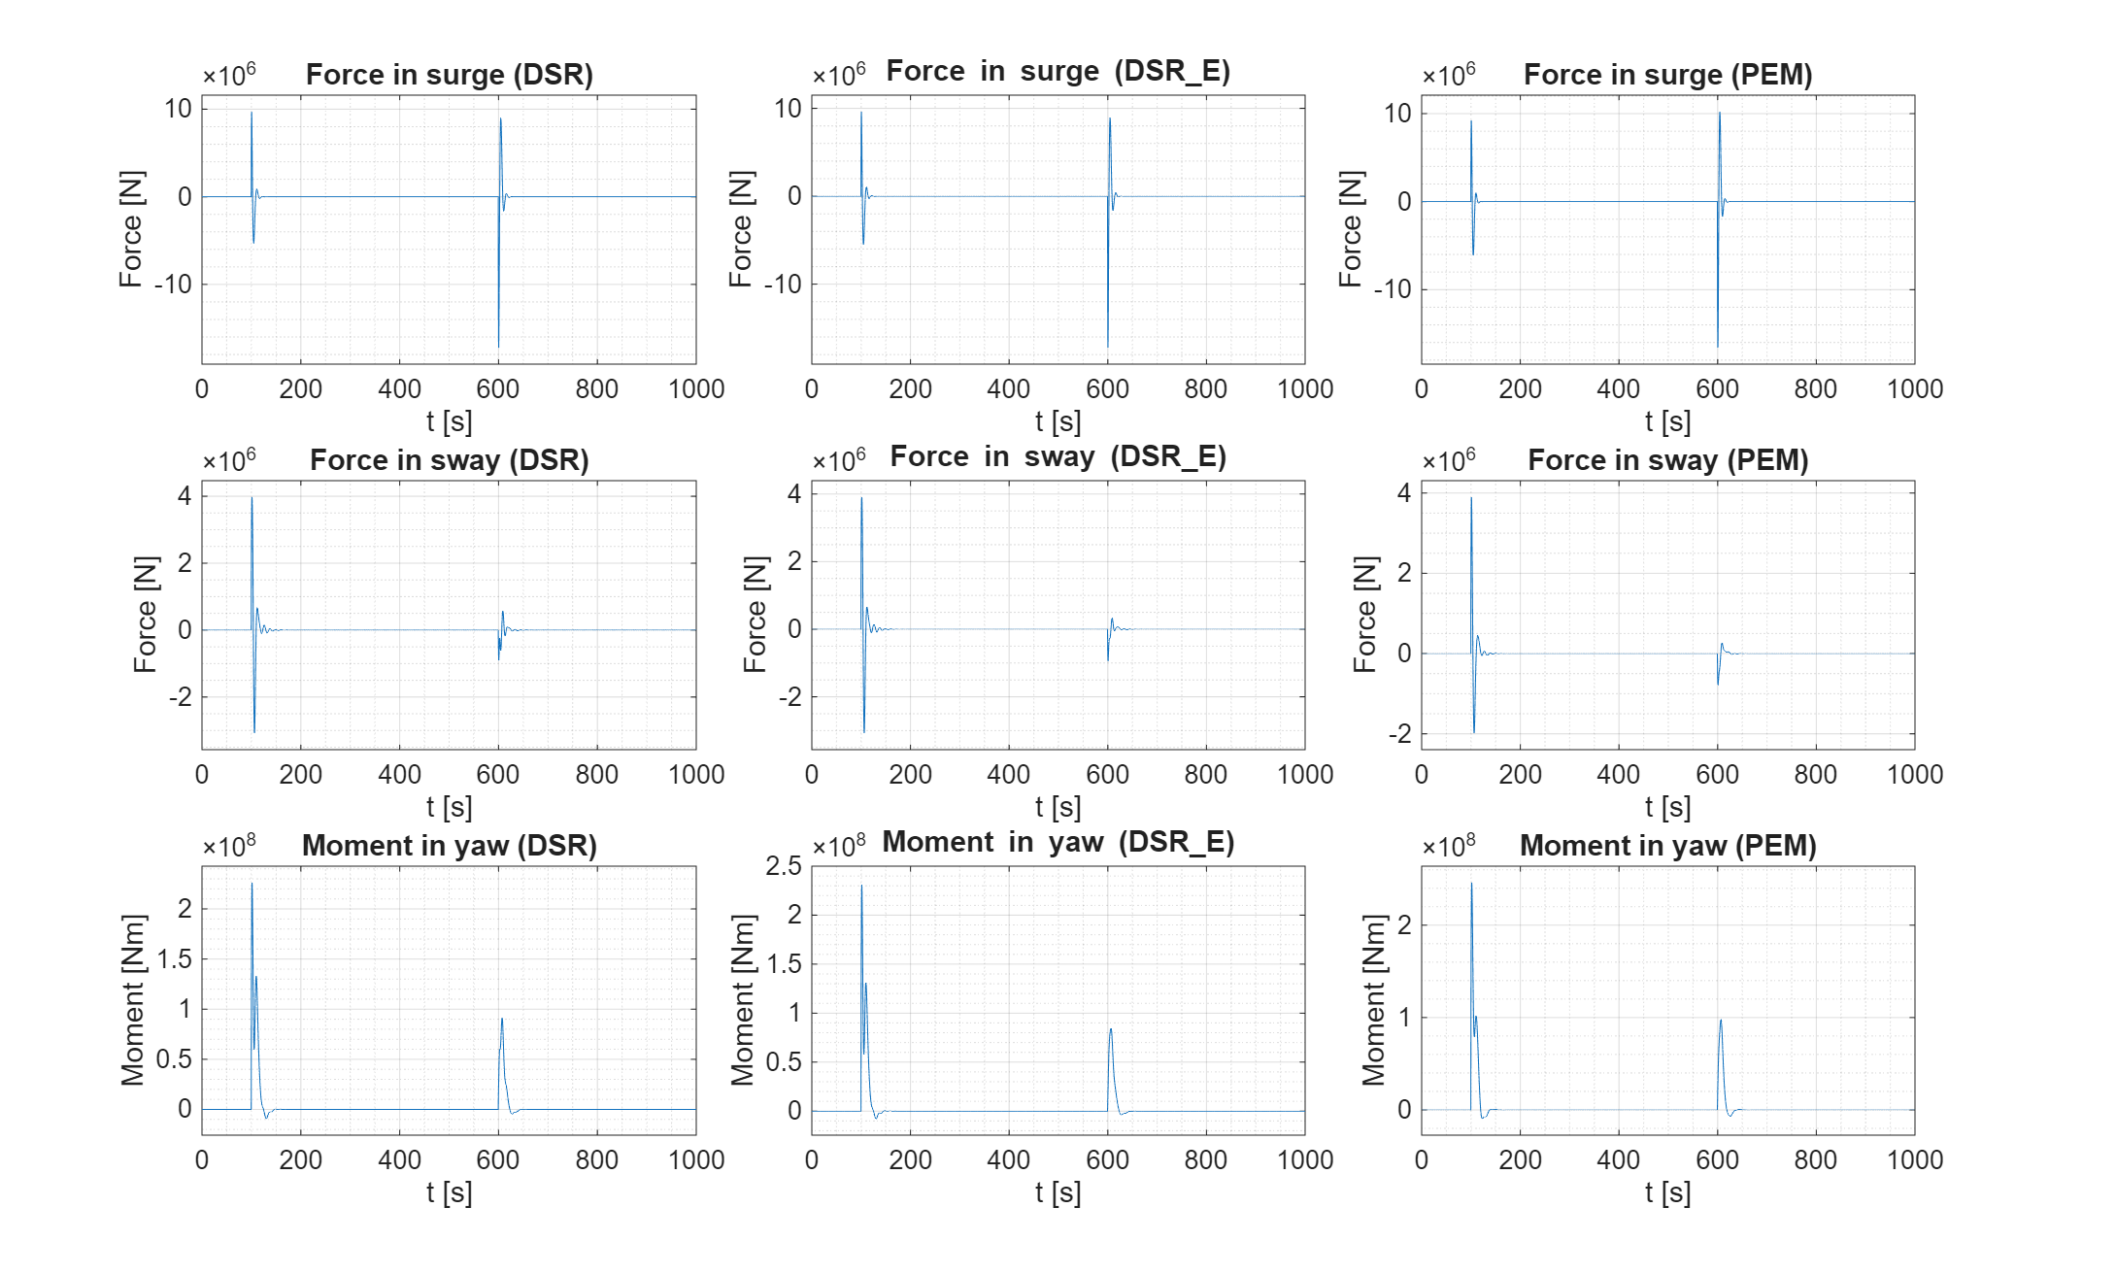
Control of SI identified vessel (OSV) using LQ optimal control
Setpoint tracking – Shows the north and east position together with the yaw angle
Inputs – Shows force in surge, force in sway, and momentum in yaw

Slide 32
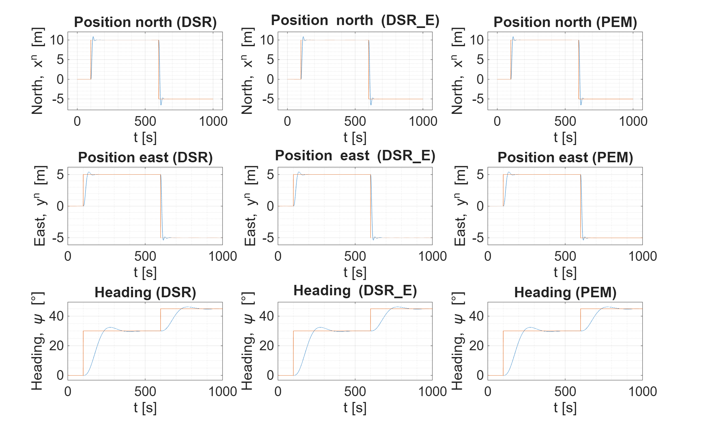
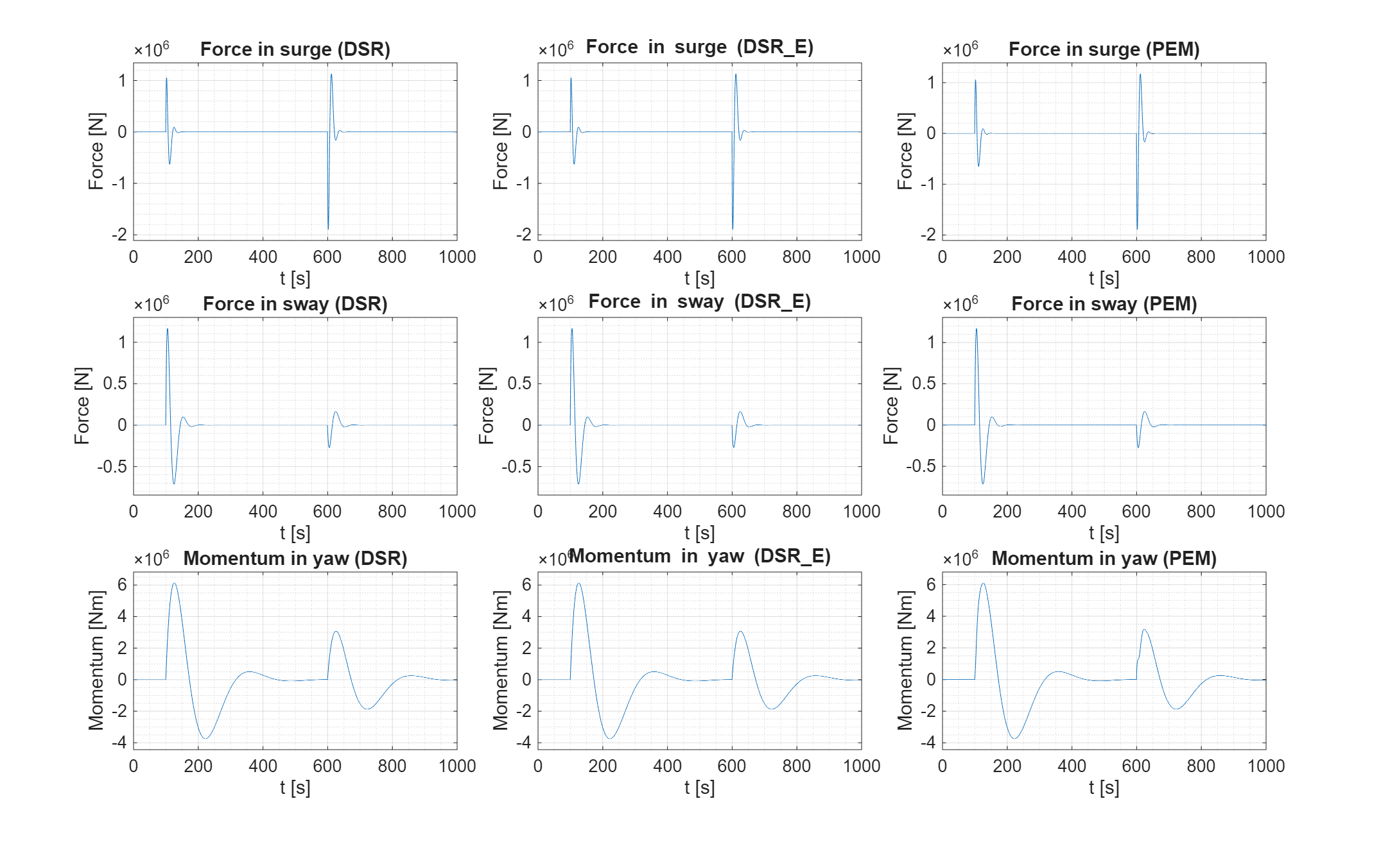
Control of SI identified vessel (Balchen) using LQ optimal control
Setpoint tracking – Shows the north and east position together with the yaw angle
Inputs – Shows input values from controller: force in surge, force in sway, and momentum in yaw.

Slide 33
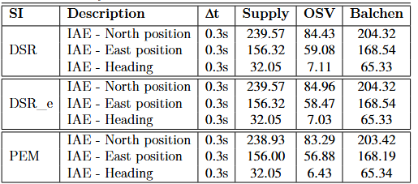
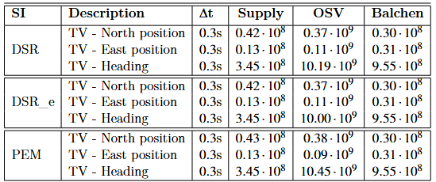
Summary
The supply and Balchen model uses net force in surge, net force in sway, and moment in yaw as input.
OSV however uses RPS. Since one unit for input here is equal to many Newtons or Newton-meters, it follows that the tuning becomes very aggressive.
Clearly all identification methods work well (DSR, DSR_e, and PEM).

Slide 34
Path following and trajectory tracking
Simple algorithms for path following and trajectory tracking

Slide 35
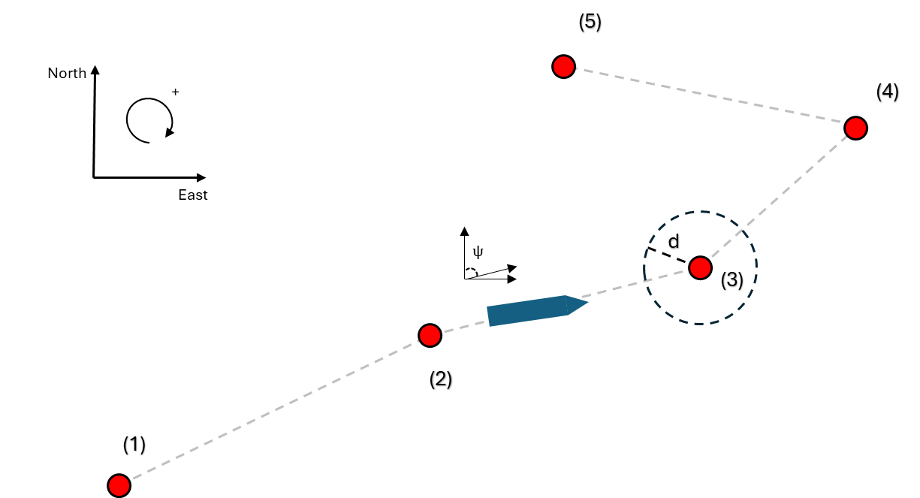
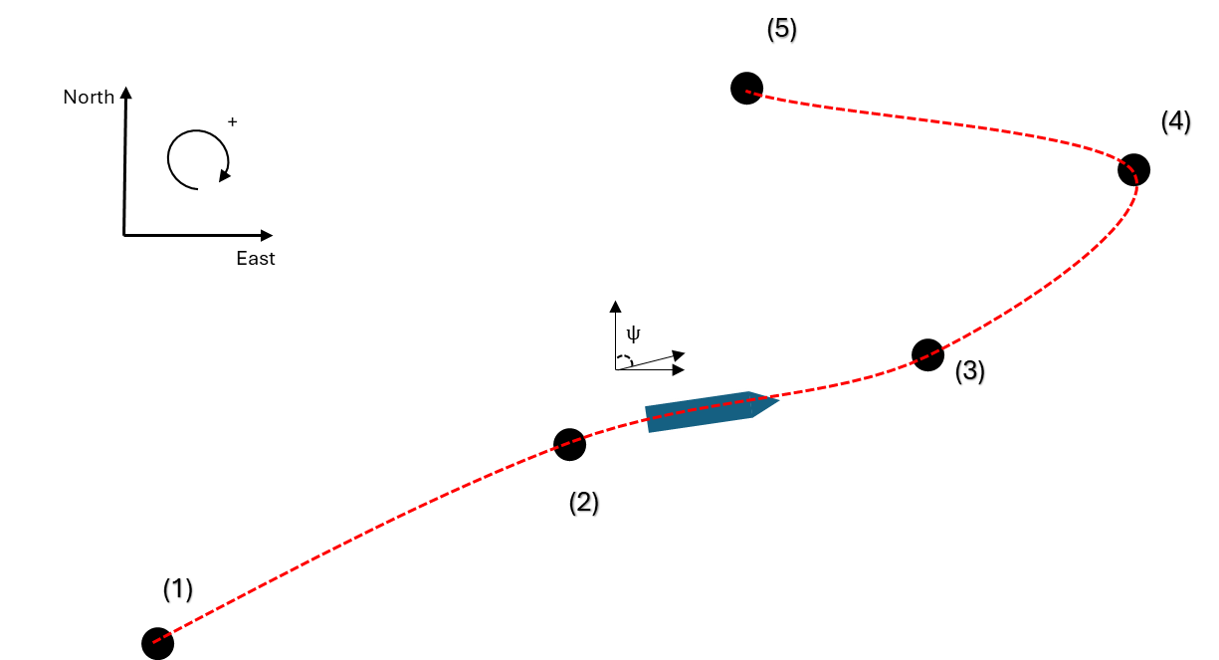
Algorithms
Path following – The active waypoint is the setpoint.
Trajectory tracking – Waypoints are used to determine setpoints using cubic spline interpolation

Slide 36
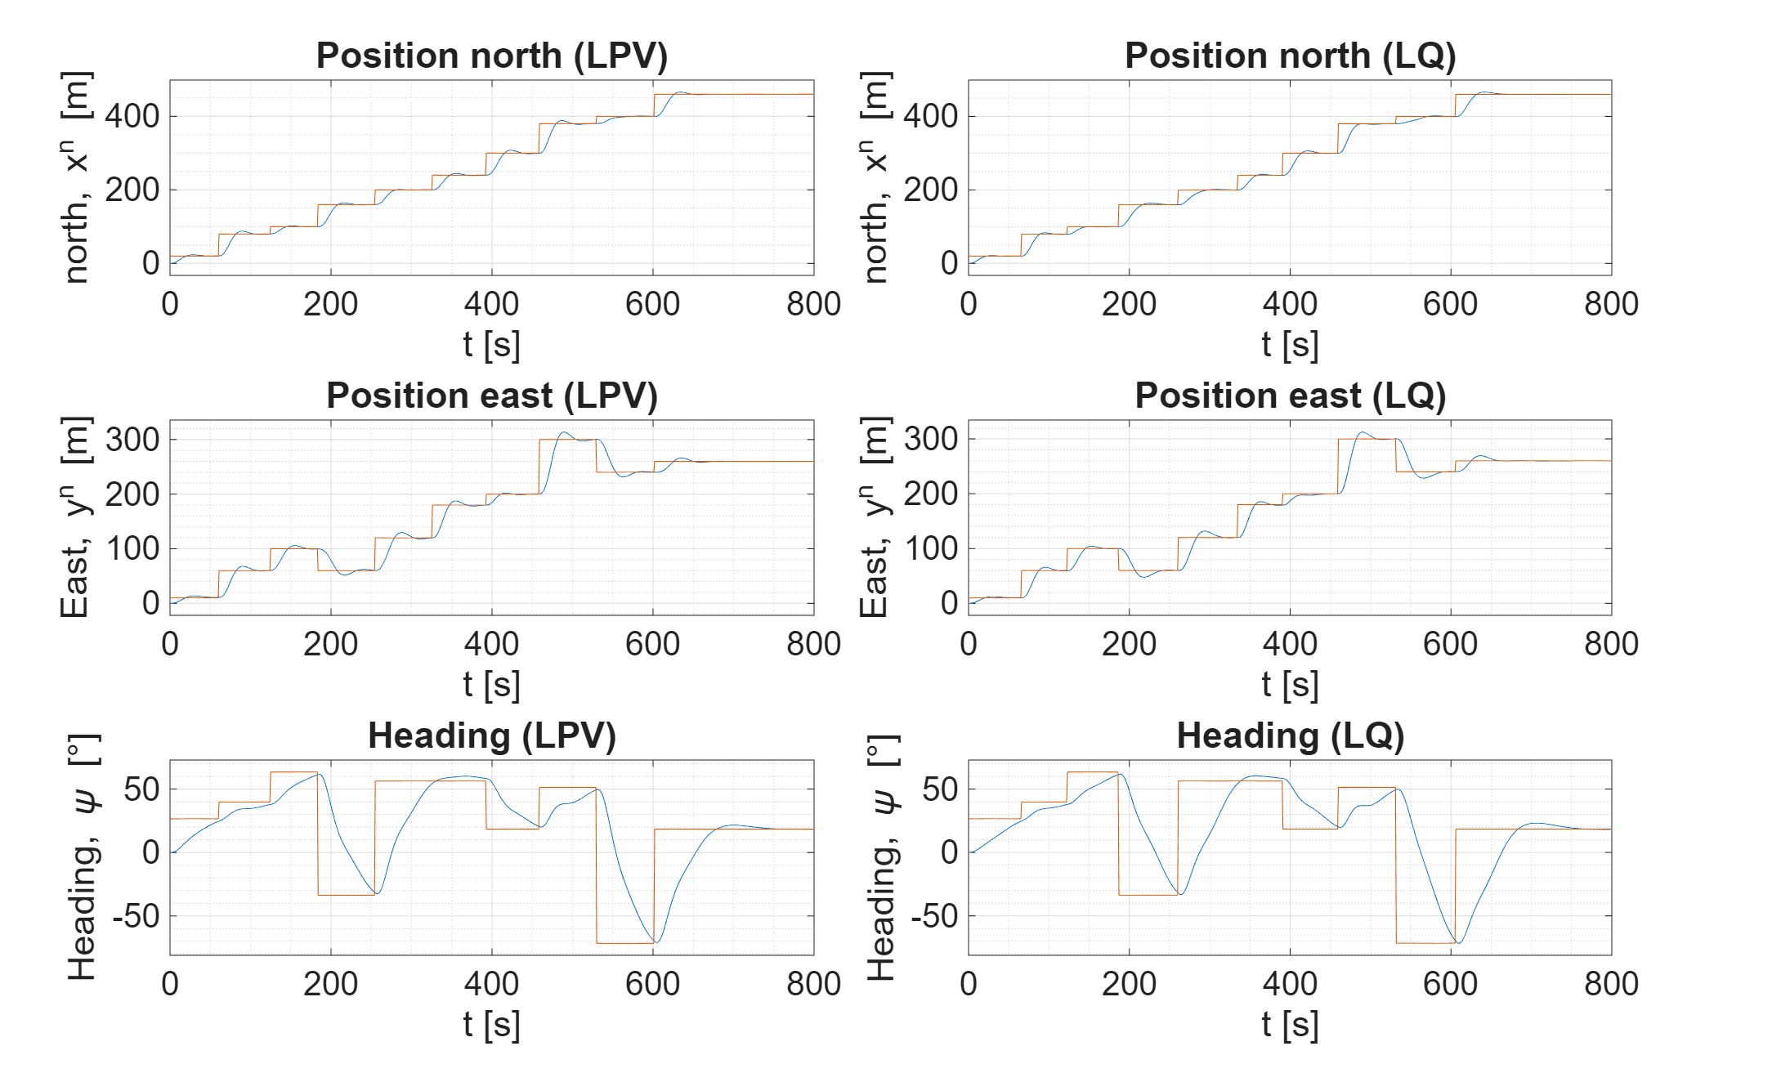
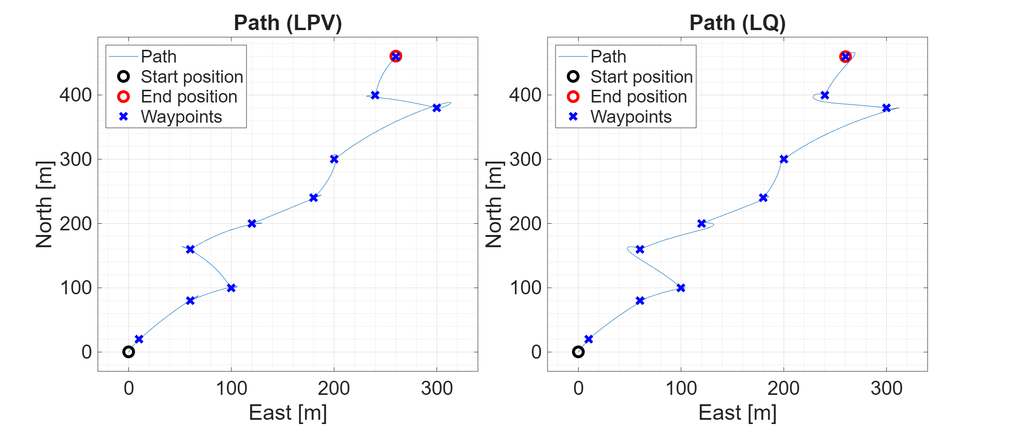
Path following
Path plot – Shows position of the vessel together with waypoints
Setpoint tracking – Shows the north and east position together with the yaw angle

Slide 37
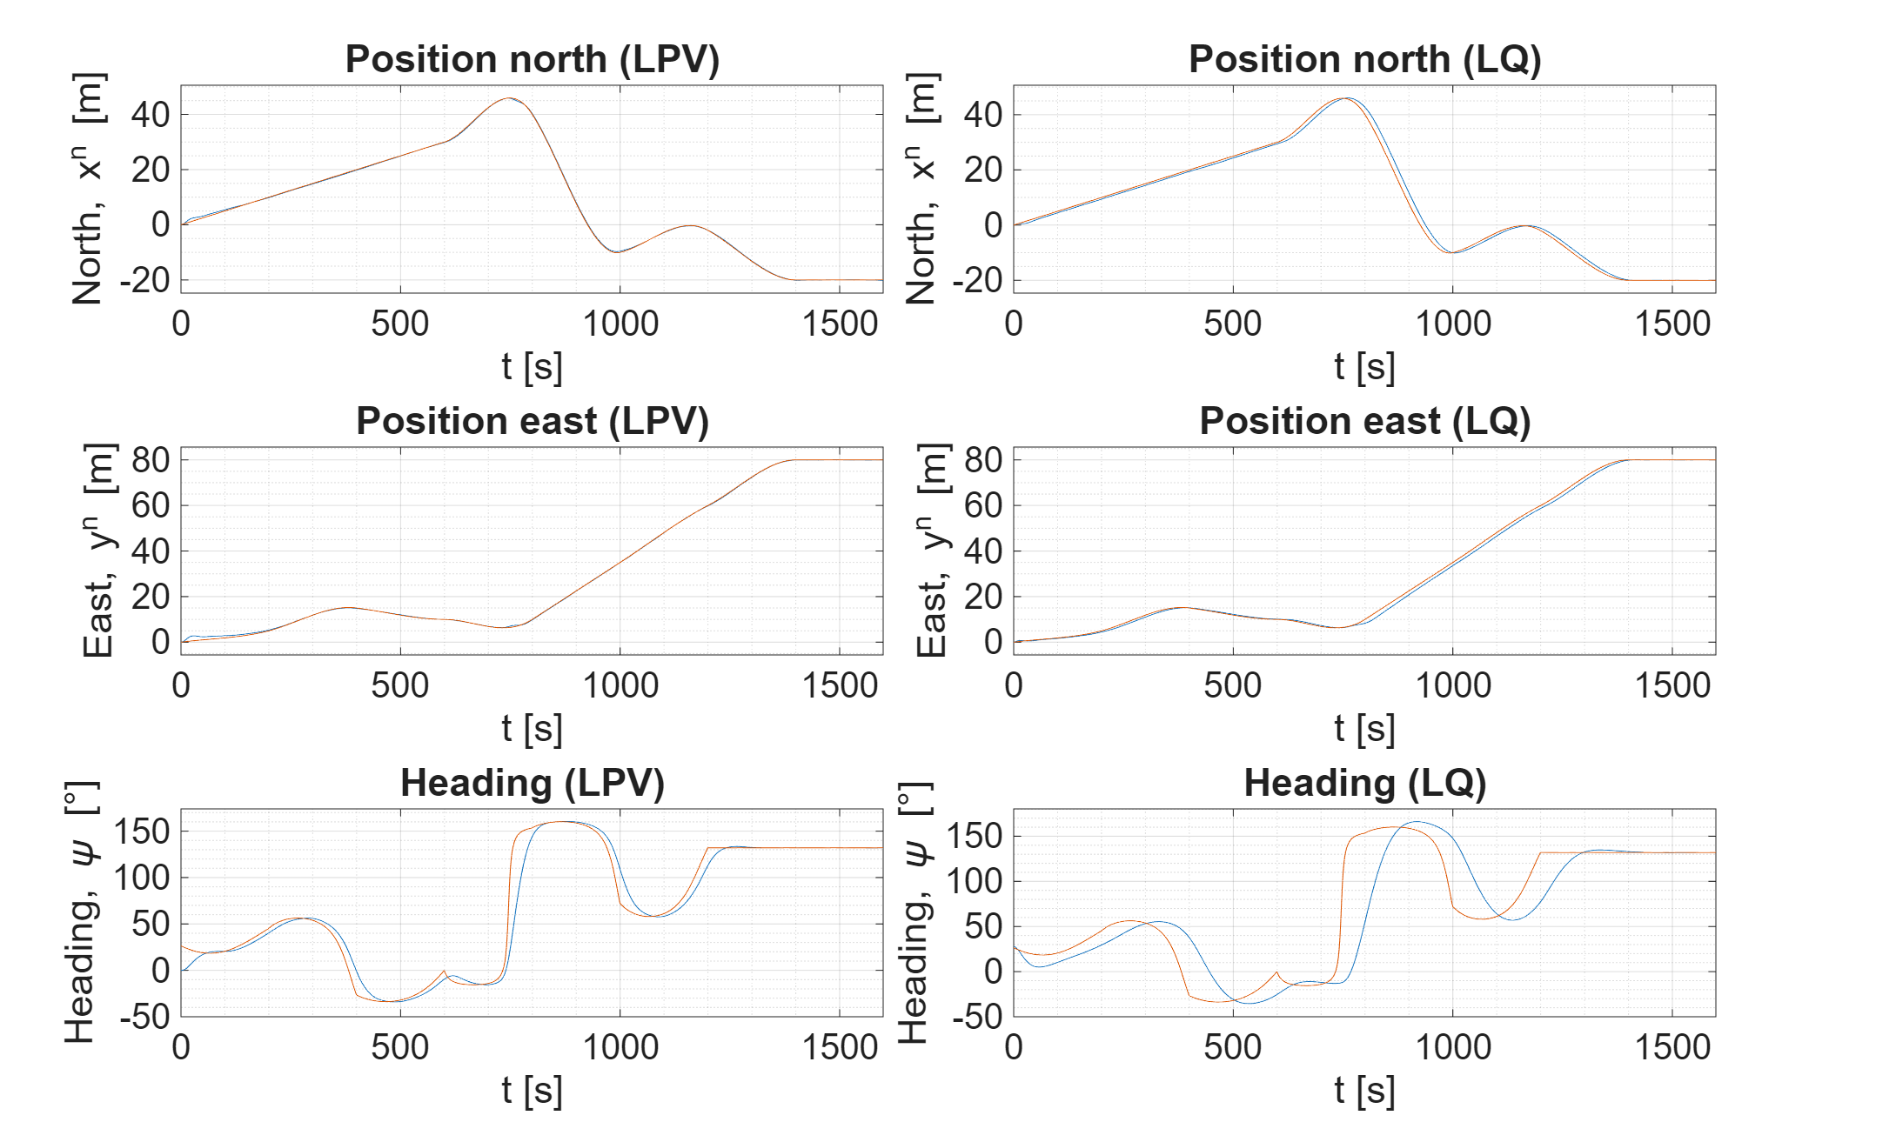
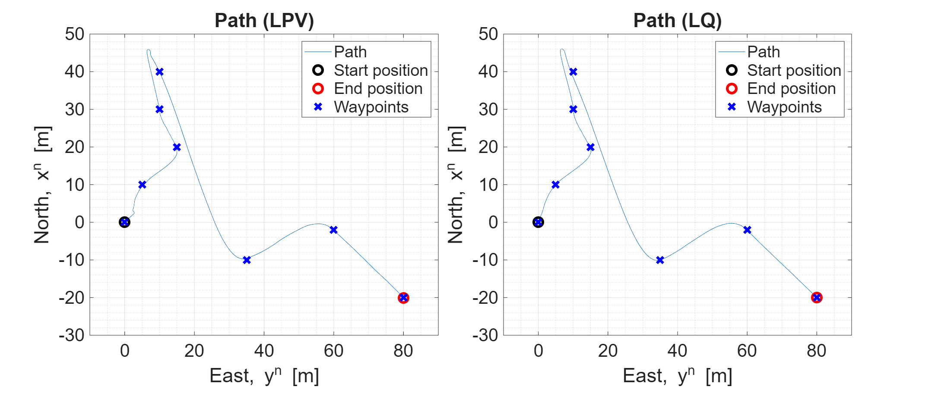
Trajectory tracking
Path plot – Shows position of the vessel together with waypoints
Setpoint tracking – Shows the north and east position together with the yaw angle

Slide 38
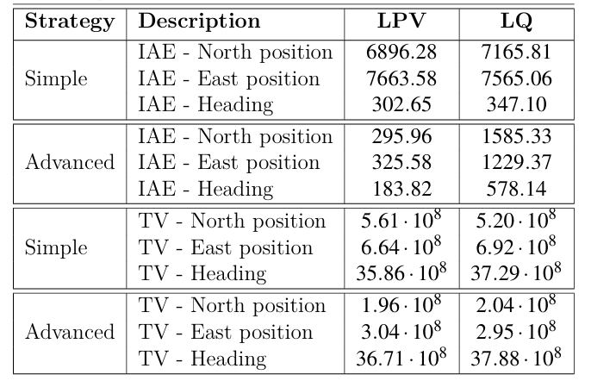
Summary
LQ optimal control and LPV performs very similar for the path following algorithm (simple).
LPV clearly outperforms LQ optimal control on trajectory tracking (advanced).
No big differences in total value.

Slide 39
Environmentally friendly DP mode
Also known as green DP in industry

Slide 40


Green DP
Define the following cost function:
It defines a circular operational area where vessel is allowed to drift with small or no penalty. Movement outside the circle is harshly penalized.

Slide 41

Comparing two types of weather conditions
Simulation set 1
Simulation set 2
Waves and current are generated by a modified random walk algorithm
With α (reduction factor) set to 0.9.
Waves and current are generated without a reduction factor, i.e., α = 1.
This allows the waves and current forces to drift far away from zero.

Slide 42




Simulation results from Monte Carlo simulation
Simulation set 1 – Mild weather conditions
Simulation set 2 – Harsher weather conditions

Slide 43
Thruster allocation
A brief introduction to thruster allocation in the context of LQ optimal control

Slide 44



Thruster allocation algorithms
Explicit solution
QP solution
Nonlinear programming

Slide 45
Thruster forces and moment
(1)
f₁
l₁
l₃
(3)
ͳ₁ = -l₁f₁ > 0
x^{b}
l₂
f₂
(2)
y^{b}
f₃
ͳ₃ = l₃f₃ > 0
ͳ₂ = -l₂f₂ < 0

Slide 46






Thruster configurations
Truster configuration
Truster configuration matrix
Nonrotatable
thrusters
Rotatable
thrusters

Slide 47
Simulations run here
Setup | Algorithm | Thruster configuration | Comment
L1 | Explicit | Ship configuration 1: Two main propellers and one bow tunnel thruster
L2 | Explicit | Ship configuration 2: Two main propellers and two tunnel thruster
QP1 | QP | Ship configuration 1: Two main propellers and one bow tunnel thruster | This simulation is not shown here. Same results as L1
QP2 | QP | Ship configuration 2: Two main propellers and two tunnel thruster | Main starboard propeller is limited in output (10⁵ Newton)
Azi | Nonlinear | Ship configuration 3: Two main propellers and two azimuths

Slide 48


Thruster allocation (explicit solution, L1)
[0, 0, 0°]
[10, 5, 30°]
[0, -5, 45°]
t = 100
t =600

Slide 49


Thruster allocation (explicit solution, L2)
[0, 0, 0°]
[10, 5, 30°]
[0, -5, 45°]
t = 100
t =600

Slide 50


Thruster allocation (QP solution, Q2)
[0, 0, 0°]
[10, 5, 30°]
[0, -5, 45°]
t = 100
t =600

Slide 51


Thruster allocation (Nonlinear solution, Azimuth)
[0, 0, 0°]
[10, 5, 30°]
[0, -5, 45°]
t = 100
t =600

Slide 52


Monte Carlo simulation

Slide 53

Demonstration – thruster allocation

Slide 54
Summary
It was shown to be feasible to control vessel using LQ optimal control, MPC and NMPC.
Control of vessel using system identification and model-based controller was shown to be possible. Even for a nonlinear vessel model.
Path following and trajectory tracking is possible. Trajectory tracking works especially well with methods using a prediction horizon.
Green DP can be beneficial under mild weather conditions.
Thruster configuration is important when performing DP. Investing in a proper thruster setup can save significant amounts of fuel.

Slide 55

Thanks for listening
Any questions?

